Slide 1


CROSS CULTURAL
COMMUNICATION

Slide 2

Culture
The way people see and
express themselves
Ideas, customs and social
behaviour of a particular group
A group that shapes a
person’s value and identity

Slide 3

Communication
The Process of interchanging thought, opinion and informations via verbal and nonverbal means i.e speech, writing or signs.

Slide 4
Cross Cultural Communication
Cross-cultural communication is the analysis the way people from various cultural backgrounds interact with each other in similar and distinct ways, as well as the way of endeavoring to communicate throughout cultures.

Slide 5
Factors Affecting Cross Cultural Communication
Language
Context
Environment and technology
Concept of authority
Nonverbal communication

Slide 6
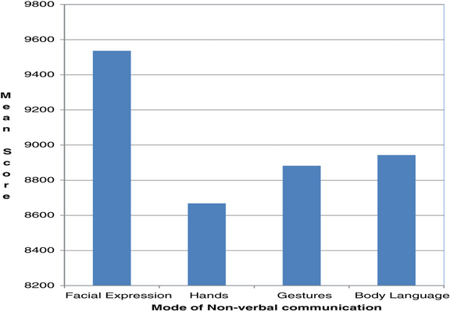
Modes Of Nonverbal Communication

Slide 7
Importance Of Cross Cultural Communication
The basic sector where cross cultural communication is must are:
In educational sector
In business
In workplace

Slide 8
In Educational Sector
Fostering acceptance for persons from various cultural backgrounds
Trying to deliver thoughts confidently, sensitively and tactfully
Providing equal chances and impartial judgment

Slide 9
In Business Sector
Ensuring equality of opportunities
Improving one's knowledge about the global market and economy.
Enhancing human resources
Achieving needs and building better business relationships
Facilitating of growth-enhancing opportunities
Stimulating the economy by increasing production and earnings

Slide 10

Misunderstanding And Misinterpretation:

Slide 11
In Workplace
Ensuring Better Work Environment
Better Understanding of Diverse Markets
Sharing your perspectives, thoughts, opinions and ideas.
Inspiring Innovation
Attract and Retainment of Top Talent
Ensuring that your creative thinking is flourishing.
Enhancing cooperation

Slide 12
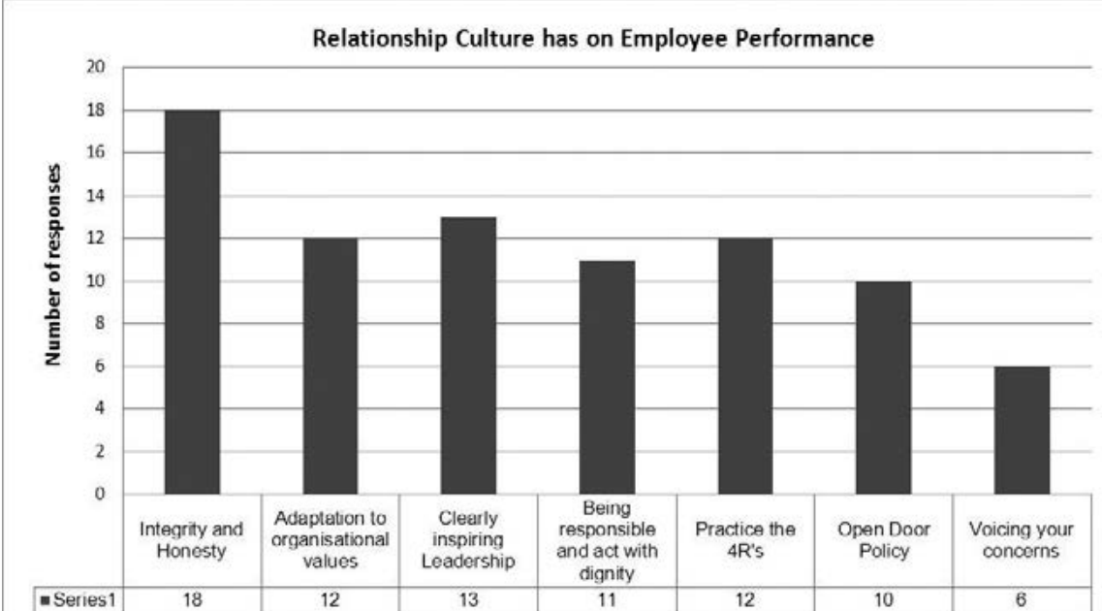
Cross Cultural Communication Effect On Employee Performance
Notes:
4R
R - Rejuvenate
Recreate, Restart, Rework

Slide 13
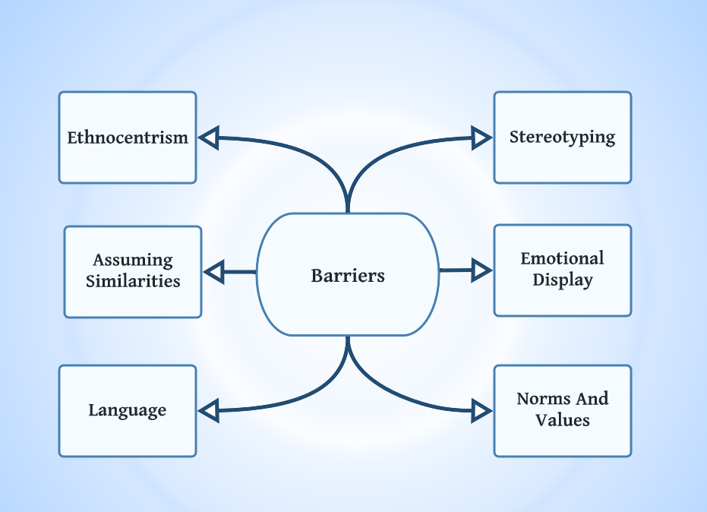
Barriers In Cross Cultural Communication

Slide 14
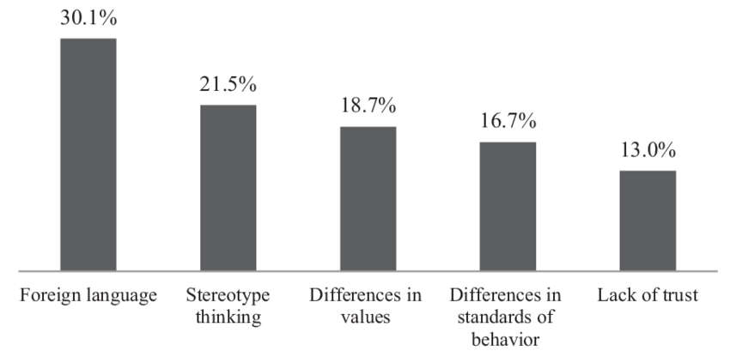
Modes Of Barriers

Slide 15
Improving Cross Cultural Communication
Enhancing self awareness
Avoid stereotyping and ethnocentrism
Adaptation capability
Active listening
Respect style preferences
Help others to adopt new culture

Slide 16

Recommendation for Effective Cross Cultural Communication
Research
Accept and adopt
Be supportive
Maintain etiquette
Take turns
Avoid negative questions
Watch the humor
Avoid slangs

Slide 17
References
Barriers to cross-cultural communication. (2016, March 31). Simplynotes - Online Notes for MBA, BBA, MCA, BCA, MCOM, BCOM, MSc., BSc., Bio Technology Engineering, Medical Notes, Projects, Last Year Papers, PPt, Entrance Exam Study Material, Vocab Builder, MBA Syllabus and MBA Collages | Simplynotes. http://www.simplynotes.in/e-notes/mbabba/business-communication/barriers-to-cross-cultural-communication/#:%7E:text=There%20are%20many%20other%20cultural,you%20are%20having%20a%20conversation.
Study.com | Take Online Courses. Earn College Credit. Research Schools, Degrees & Careers. (2022). Study.Com. https://study.com/learn/lesson/emotional-display-rules-examples-psychology.html
Barriers to Cross-Cultural Communication | Free Essay Example. (2022, February 27). StudyCorgi.Com. https://studycorgi.com/barriers-to-cross-cultural-communication/

